Slide 1
Distributing quantum correlations through local operations and classical resources
Adam G. Hawkins
PhD Student at QUB
2025-03-18

Slide 2
Correlations in quantum information theory
In quantum information theory, states can possess classical and quantum correlations.
For pure bipartite states, the quantum correlations are quantified by the entanglement.
For mixed states this may not be the case; separable states can possess quantum correlations.
These generalized quantum correlations can be quantified by the quantum discord.

Slide 3
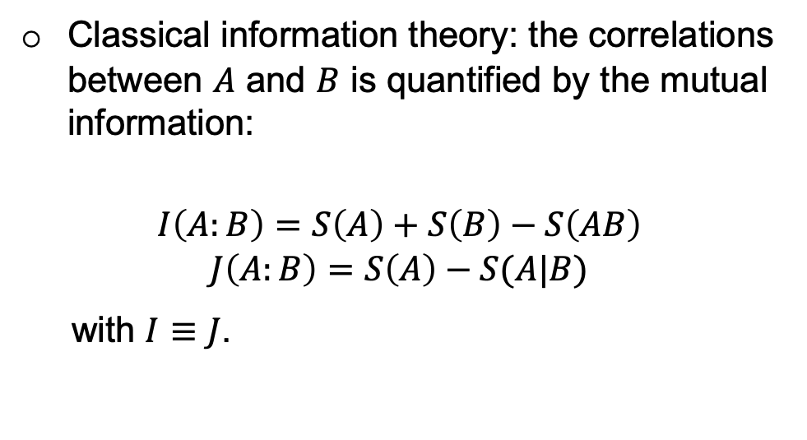
Quantum discord: what actually is it?
Classical information theory: the correlations between $A$ and $B$ is quantified by the mutual information:
$$I\left(A:B\right)=S\left(A\right)+S\left(B\right)−S\left(AB\right)$$
$$J\left(A:B\right)=S\left(A\right)−S(A|B)$$
with $I≡J$.

Slide 4
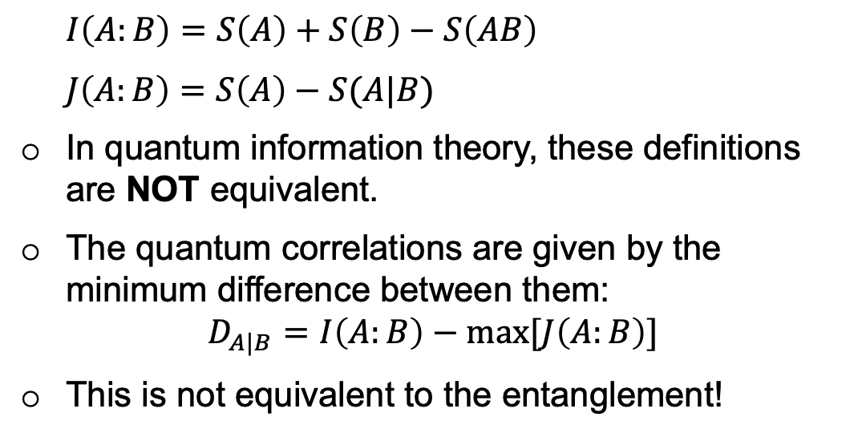
Quantum discord: what actually is it?
$I\left(A:B\right)=S\left(A\right)+S\left(B\right)−S\left(AB\right)$
$J\left(A:B\right)=S\left(A\right)−S(A|B)$
In quantum information theory, these definitions are NOT equivalent.
The quantum correlations are given by the minimum difference between them:
$$D_{A|B}=I\left(A:B\right)−\max{[J\left(A:B\right)]}$$
This is not equivalent to the entanglement!
Total correlations
Classical correlations

Slide 5
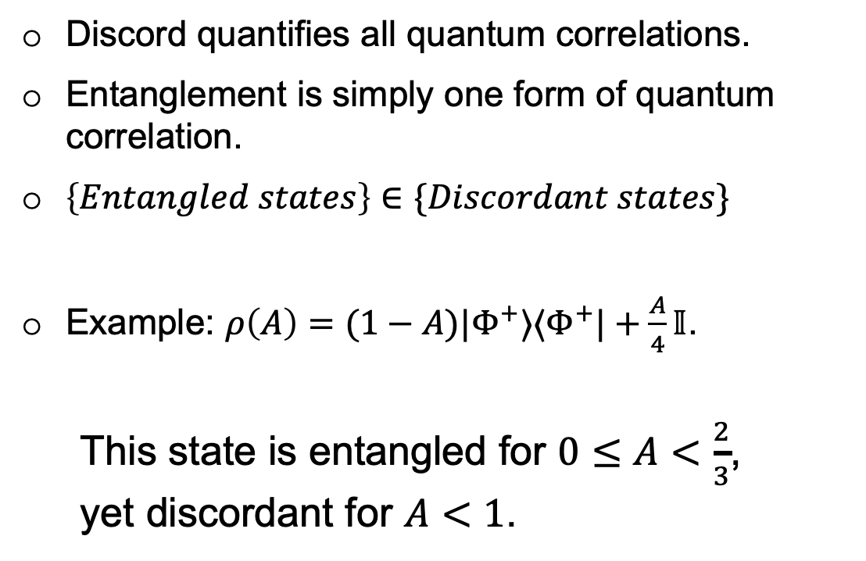
Discord vs entanglement
Discord quantifies all quantum correlations.
Entanglement is simply one form of quantum correlation.
$\left\{Entangled states\right\}∈\{Discordant states\}$
Example: $ρ\left(A\right)=(1−A)|Φ^{+}⟩⟨Φ^{+}|+\frac{A}{4}𝕀$.
This state is entangled for $0≤A<\frac{2}{3}$,
yet discordant for $A<1$.

Slide 6
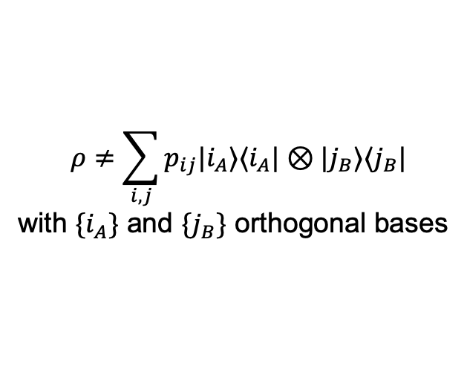
Quantum correlations hierarchy
Discord
$$ρ≠\sum_{i,j}{p_{ij}|i_{A}⟩⟨i_{A}|⊗|j_{B}⟩⟨j_{B}|}$$
with $\{i_{A}\}$ and $\{j_{B}\}$ orthogonal bases
Entanglement
Steering
Bell
Non-locality
(Not to scale)

Slide 7
Quantum discord: what is it good for?
Device-dependent QKD
Remote state preparation
DQC1 quantum computation
Assisted state discrimination
Entanglement distribution
Resource = Discord

Slide 8
Quantum discord: what is it good for?
More robust to noise than entanglement.
Unlike entanglement, discord can be locally generated!
Sudden death of entanglement

Slide 9
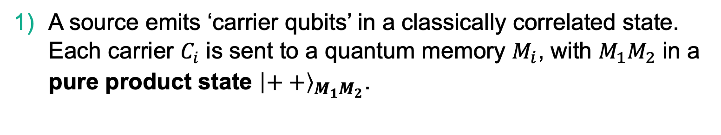
Distribution of discord: a protocol
SOURCE
A source emits ‘carrier qubits’ in a classically correlated state. Each carrier $C_{i}$ is sent to a quantum memory $M_{i}$, with $M_{1}M_{2}$ in a pure product state ${\left|++\right\rangle }_{M_{1}M_{2}}$.

Slide 10
Distribution of discord: a protocol
SOURCE
CPHASE
CPHASE
Each carrier is interacts with its respective memory, realizing a CPHASE (CZ) gate between them.

Slide 11
Distribution of discord: a protocol
SOURCE
RESOURCE = CLASSICAL CORRELATIONS!
Each carrier is measured in some local basis.
There now exists quantum correlations between the memories, independent of the measurement outcomes.
The discord is determined only by the choice of basis.

Slide 12
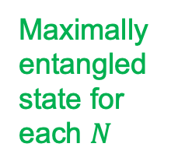
How much discord can we generate?
Number of memories
Maximally entangled state for each $N$

Slide 13
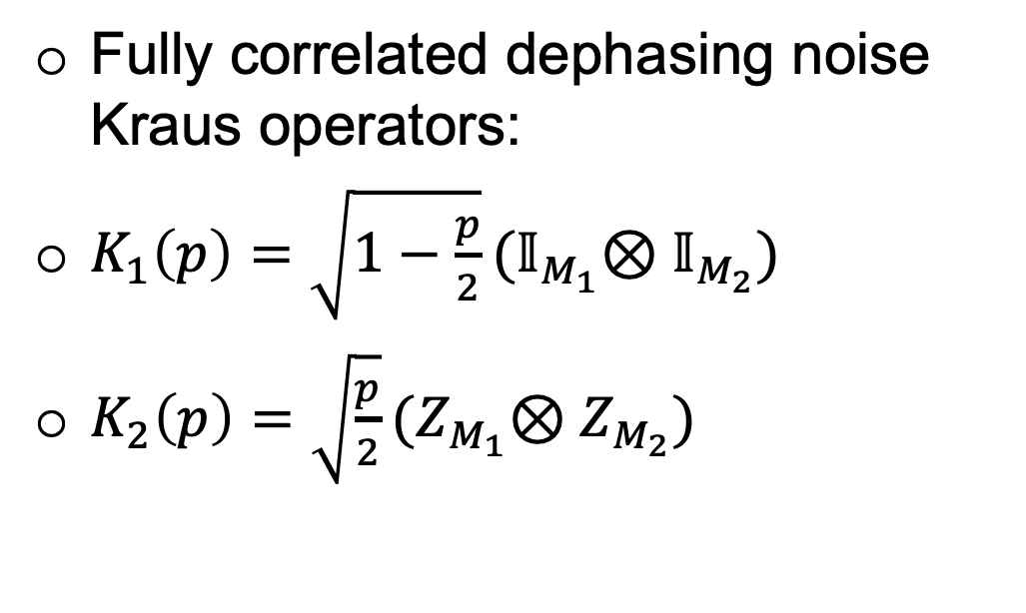
Adding correlated noise to the initial state of the memories
Fully correlated dephasing noise Kraus operators:
$K_{1}\left(p\right)=\sqrt{1−\frac{p}{2}}{(𝕀}_{M_{1}}⊗𝕀_{M_{2}})$
$K_{2}\left(p\right)=\sqrt{\frac{p}{2}}{(Z}_{M_{1}}⊗Z_{M_{2}})$

Slide 14
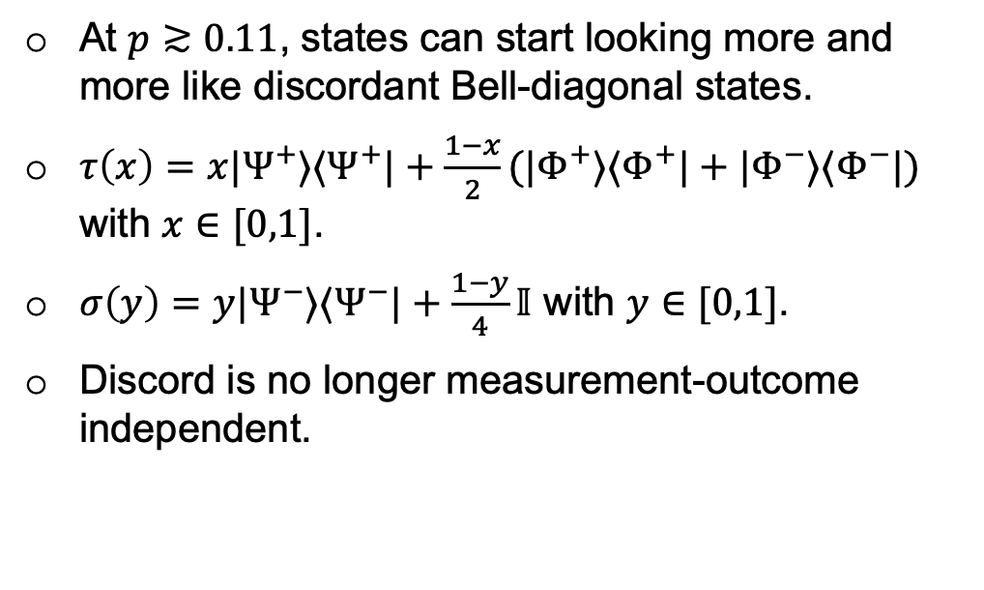
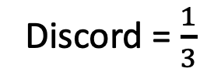
Adding correlated noise to the initial state of the memories
Discord = $\frac{1}{3}$
At $p≳0.11$, states can start looking more and more like discordant Bell-diagonal states.
$τ\left(x\right)=x|Ψ^{+}⟩⟨Ψ^{+}|+\frac{1−x}{2}(|Φ^{+}⟩⟨Φ^{+}|+|Φ^{−}⟩⟨Φ^{−}|)$ with $x∈[0,1]$.
$σ\left(y\right)=y|Ψ^{−}⟩⟨Ψ^{−}|+\frac{1−y}{4}𝕀$ with $y∈[0,1]$.
Discord is no longer measurement-outcome independent.

Slide 15
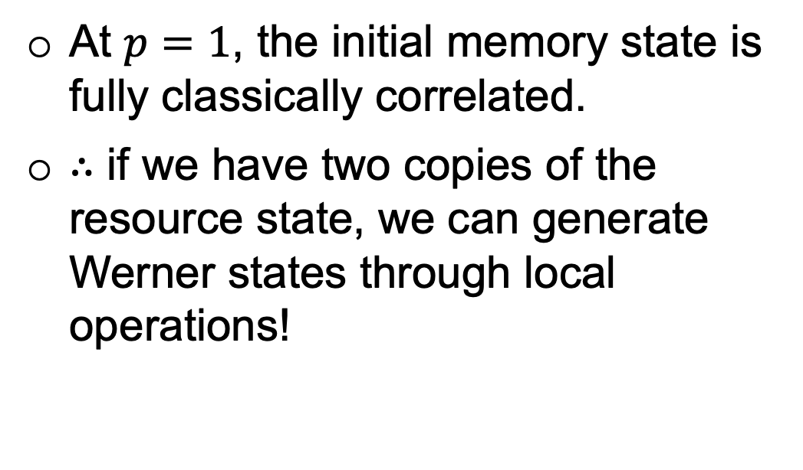
Adding correlated noise to the initial state of the memories
Discord = $\frac{1}{3}$
At $p=1$, the initial memory state is fully classically correlated.
$∴$ if we have two copies of the resource state, we can generate Werner states through local operations!

Slide 16
Conclusions
Classical correlation is a resource for locally generating quantum correlations.
The degree of quantum correlations only depends on the choice of measurement bases.
The protocol scales well with the number of qubits.
Sufficient classical correlations can be used to generate Bell-diagonal states.

